Slide 1

S&I Lab
Cross Site Scripting (XSS)
Sangwook Yun

Slide 2
Contents
Cross Site Scripting XSS
Basic Overview
Hands on
Low
Medium
High
How to Prevent XSS
XSS attack automation (Puppeteer)

Slide 3
Cross Site Scripting (XSS)

Slide 4
Overview
Cross-Site Scripting (XSS) attacks are a type of injection, in which malicious scripts are injected into otherwise benign and trusted websites. XSS attacks occur when an attacker uses a web application to send malicious code, generally in the form of a browser side script, to a different end user. Flaws that allow these attacks to succeed are quite widespread and occur anywhere a web application uses input from a user within the output it generates without validating or encoding it.

Slide 5
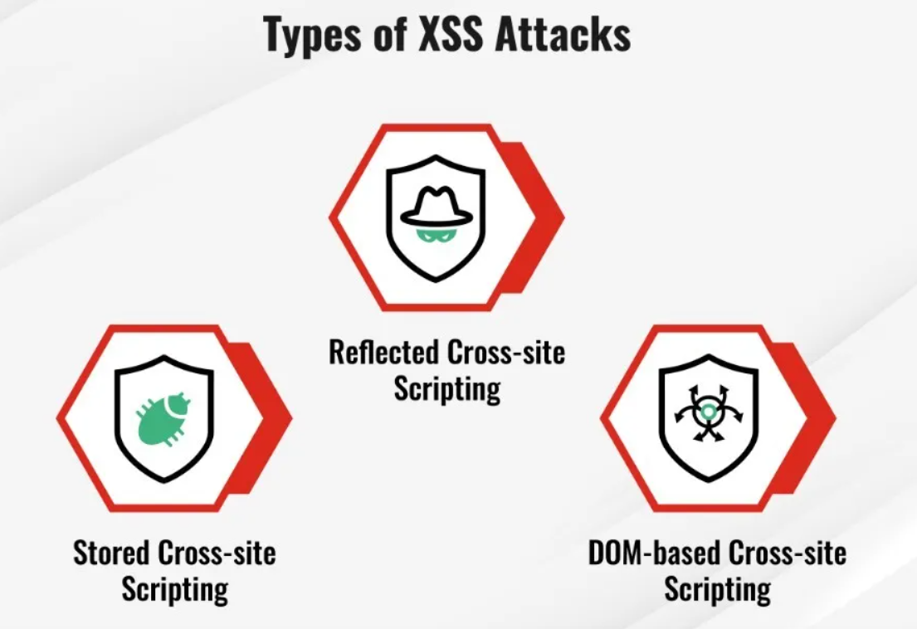
Overview

Slide 6
Hands-on DVWA
Low Level
Medium Level
High Level

Slide 7
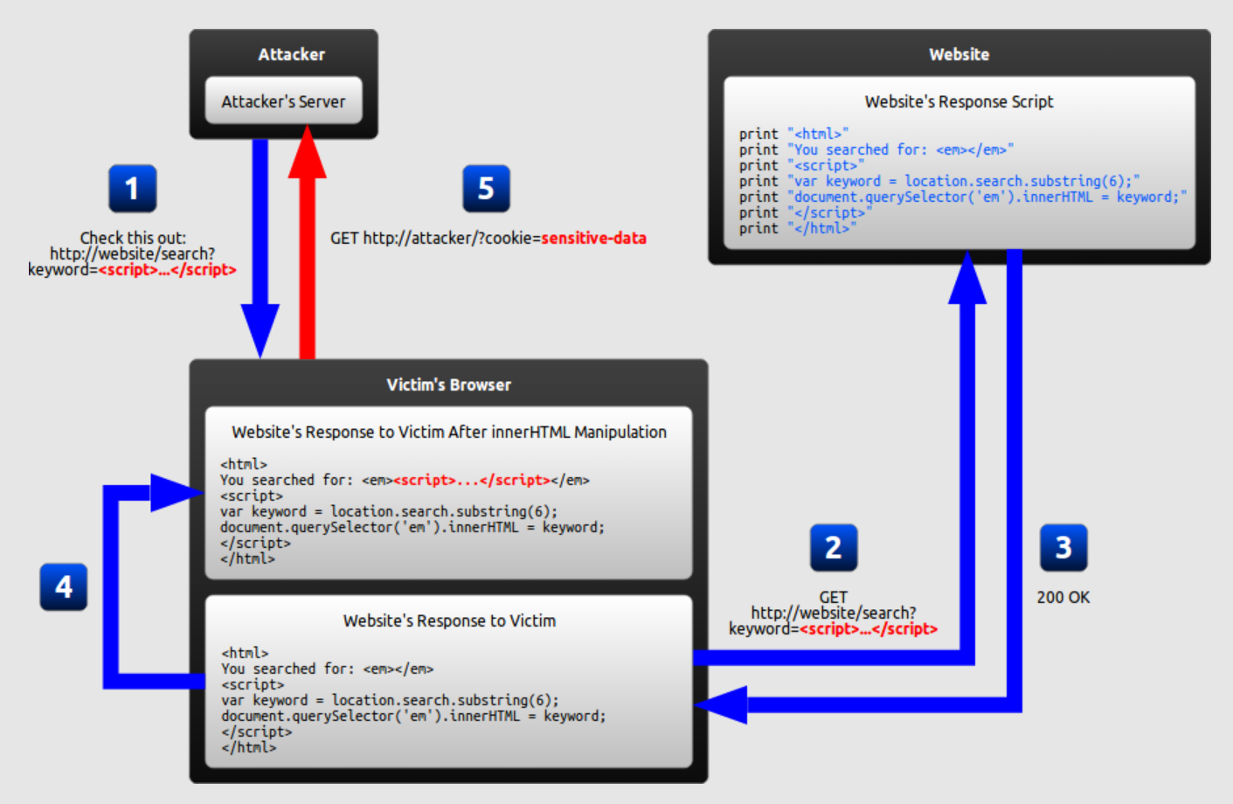
DOM-Based XSS

Slide 8
DOM-Based XSS
A client-side JavaScript takes input from any attacker-controllable source and passes it without validation into a sink that execute code dynamically
Attacker-controllable source can be
responsible for accepting some input or an object properties
An object properties
Parameters of the URL which accepts user input.
E.g) location.search, location.href, document.referrer, document.location.
Sink is the reflection point that eventually executes the malicious JavaScript injected through the source. Example of execution sink : document.write(), document.writeln(), element.innerHTML
“DOM-based XSS is all about playing with Source and Executable Sink”

Slide 9
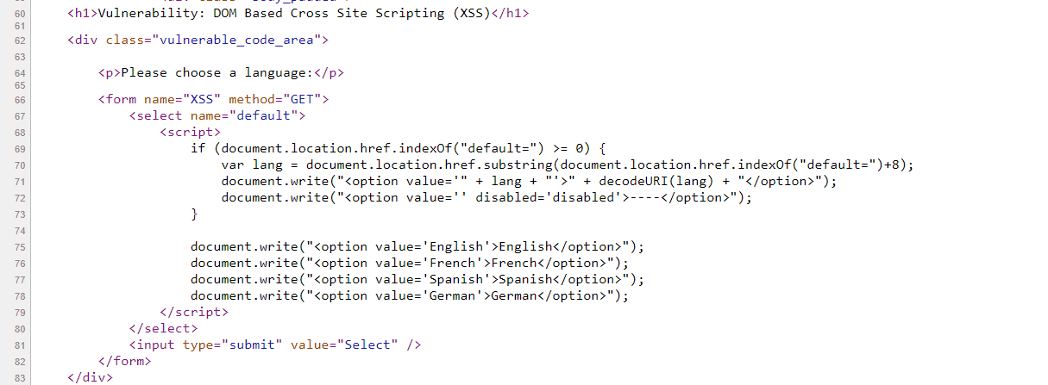
DOM-Based XSS
Security Level : Low
“First step is to find potential source where we can inject our XSS payload”

Slide 10
DOM-Based XSS
Security Level : Low
Source
Sink
“First step is to find potential source where we can inject our XSS payload”

Slide 11
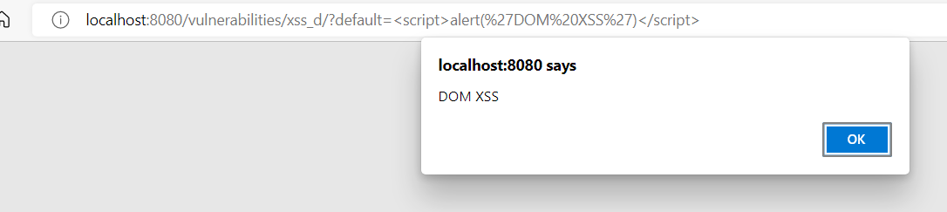
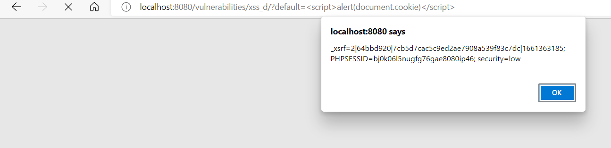
DOM-Based XSS
Security Level : Low
<script>alert(‘DOM XSS’)</script>
<script>alert(document.cookie)</script>

Slide 12
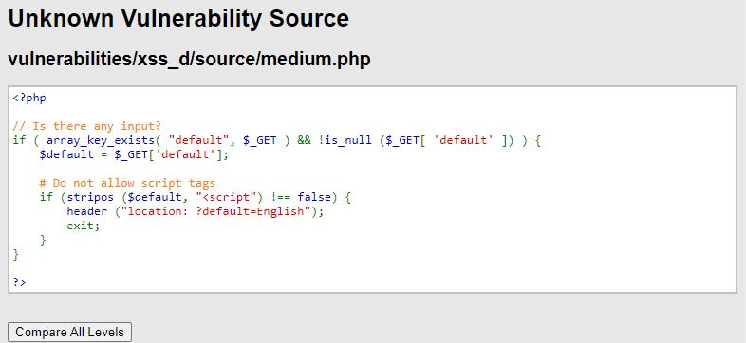
DOM-Based XSS
Security Level : Medium
Block executing <script>…</script>
“There are several ways to execute payload”

Slide 13
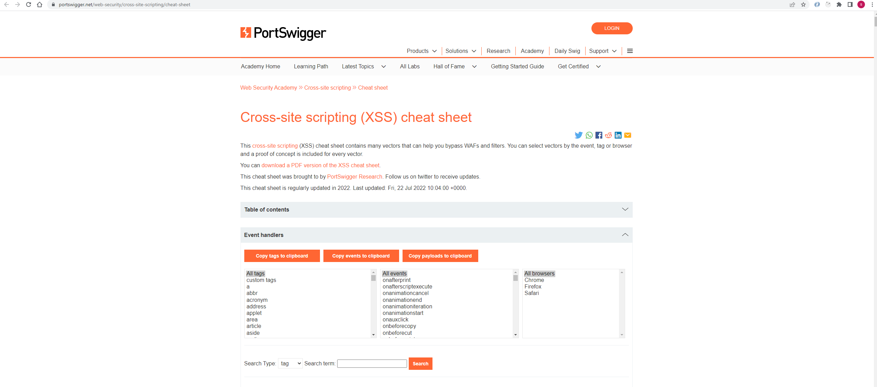
DOM-Based XSS
Security Level : Medium
Notes:
https://portswigger.net/web-security/cross-site-scripting/cheat-sheet

Slide 14
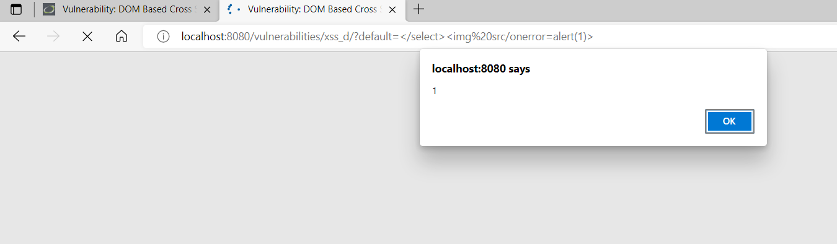
DOM-Based XSS
Security Level : Medium
</select><img src=x onerror=alert(“1”)>
</select><svg onload=alert(‘XSS’)>
</select><body onload=alert(‘XSS’)>

Slide 15
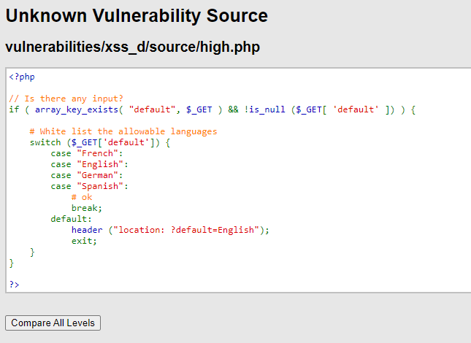
DOM-Based XSS
Security Level : High

Slide 16
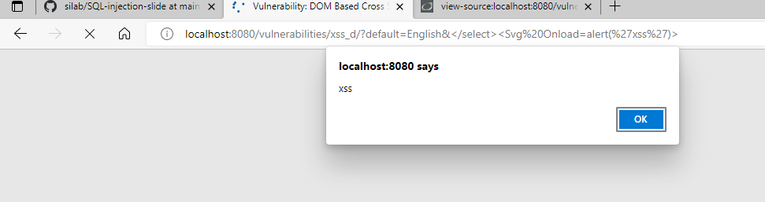
DOM-Based XSS
Security Level : High
English&</select><Svg Onload=alert(‘xss’)
English&</select><body onload=alert(‘xss’)

Slide 17
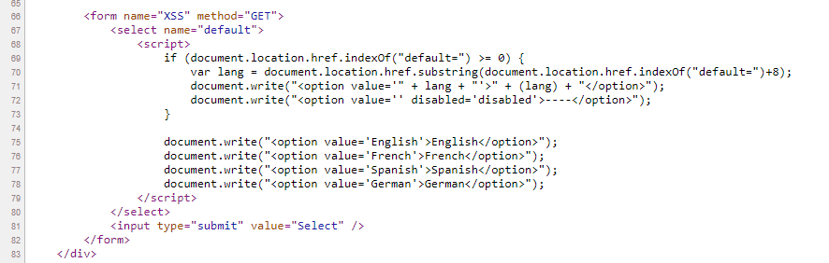
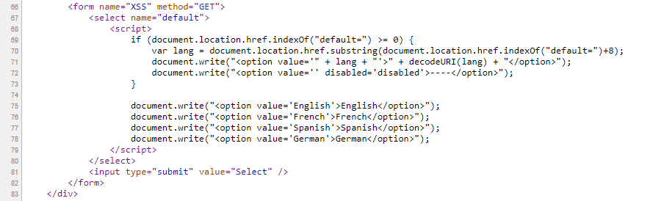
DOM-Based XSS
Security Level : Impossible

Slide 18
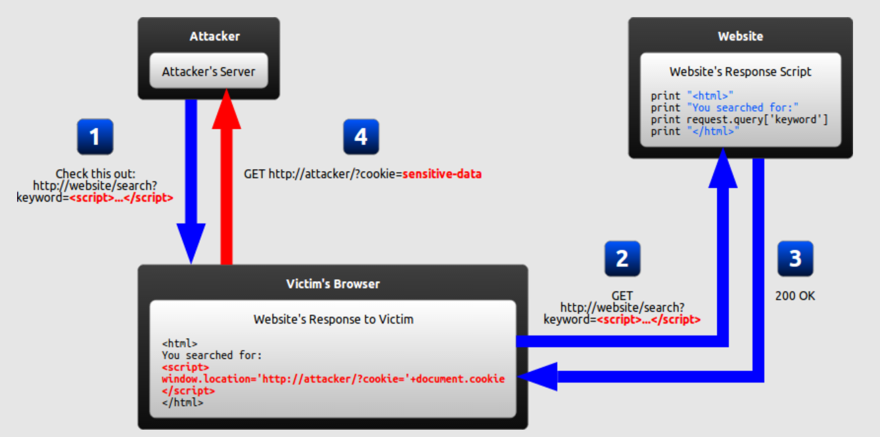
Reflected XSS

Slide 19
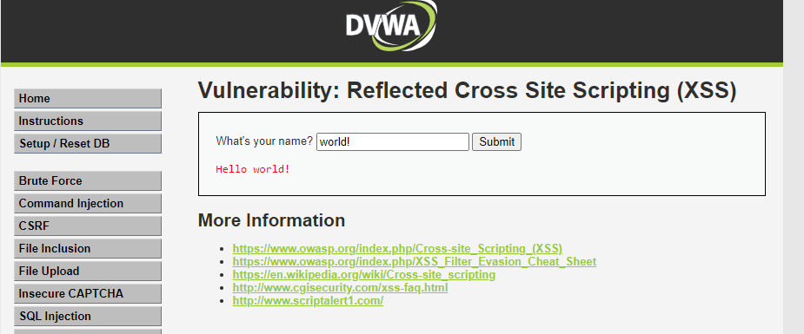
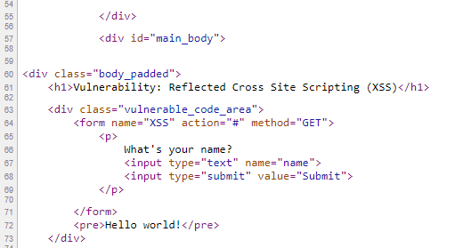
Reflected XSS
Security Level : Low

Slide 20
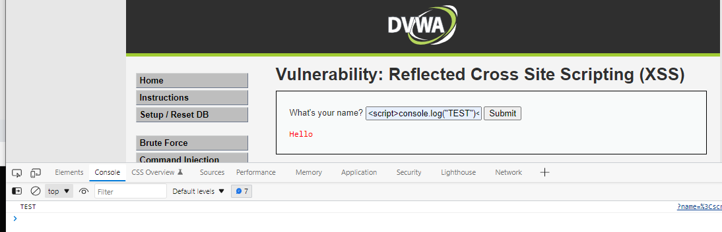
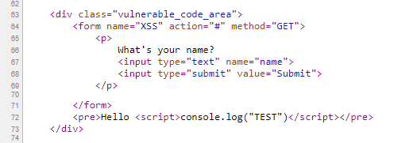
Reflected XSS
Security Level : Low

Slide 21
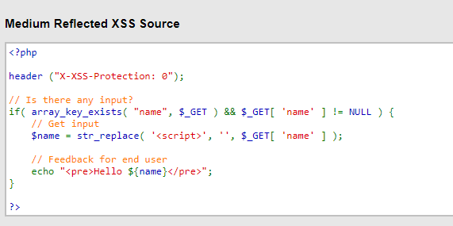
Reflected XSS
Security Level : Medium

Slide 22
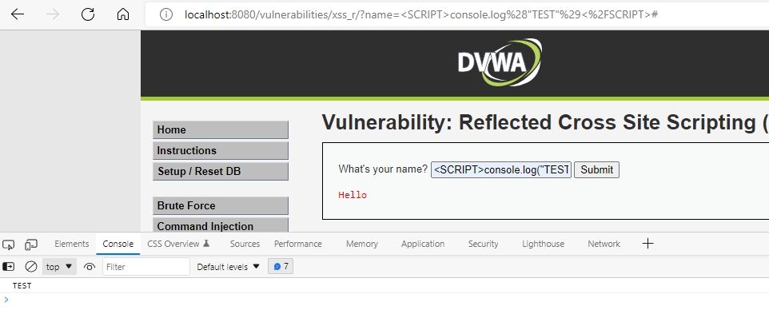
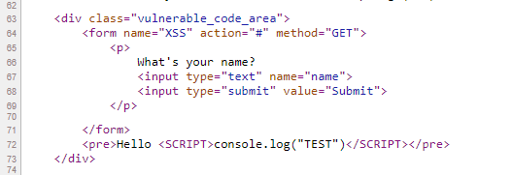
Reflected XSS
Security Level : Medium

Slide 23
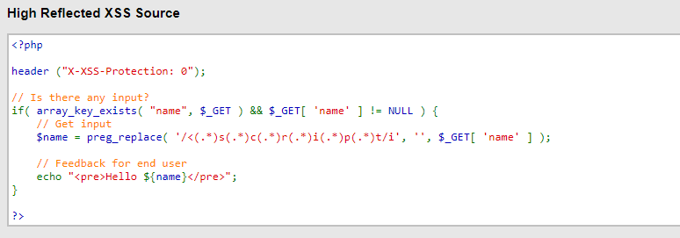
Reflected XSS
Security Level : High
“There are several ways to execute payload”

Slide 24
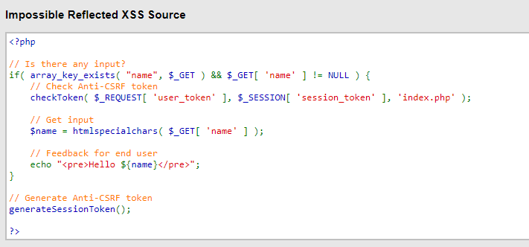
Reflected XSS
Security Level : Impossible

Slide 25
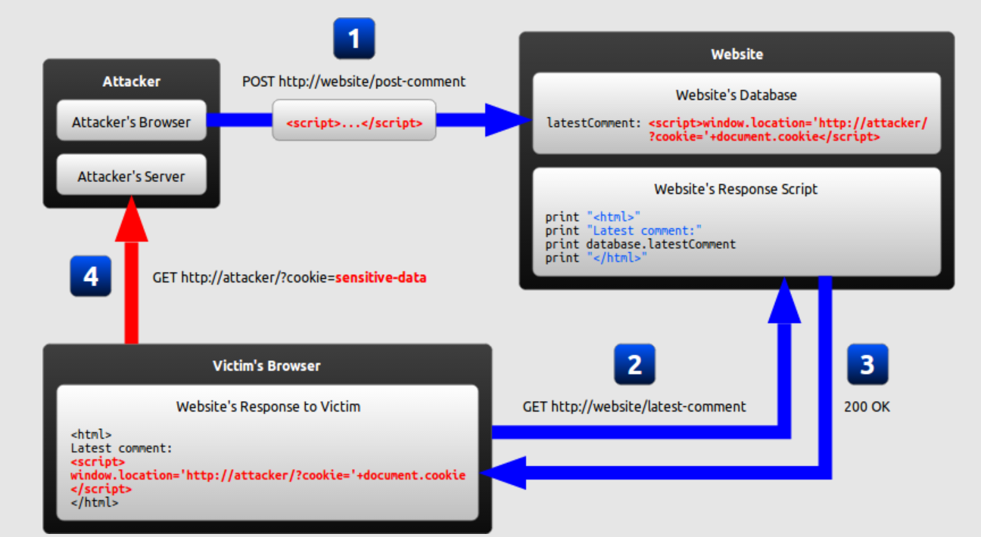
Stored XSS

Slide 26
Stored XSS
The most dangerous cross-site scripting vulnerability
Arises whenever a web application stores user-supplied data for later use in the backend without performing any filter or input sanitization.
Commonly seen in
Forum or Message Board
Blog comments of any post
Shopping cart of e-commerce website

Slide 27
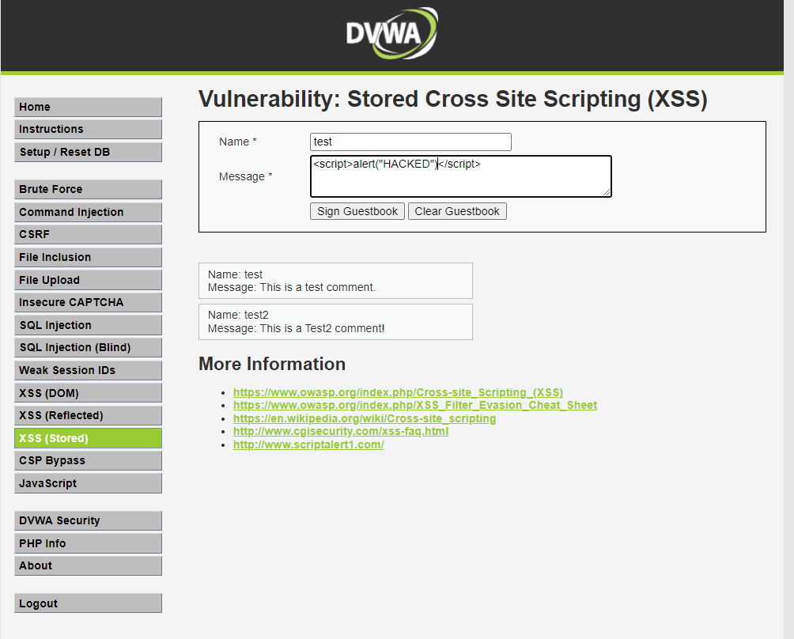
Stored XSS
Security Level : Low

Slide 28
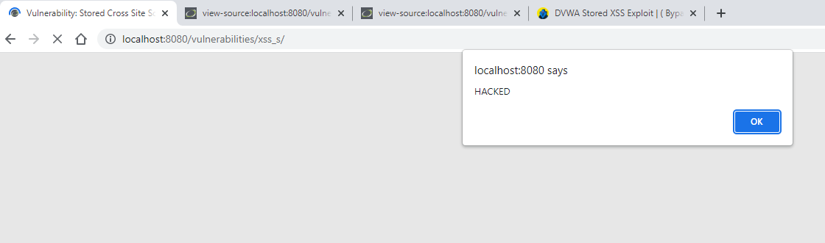
Stored XSS
Security Level : Low

Slide 29
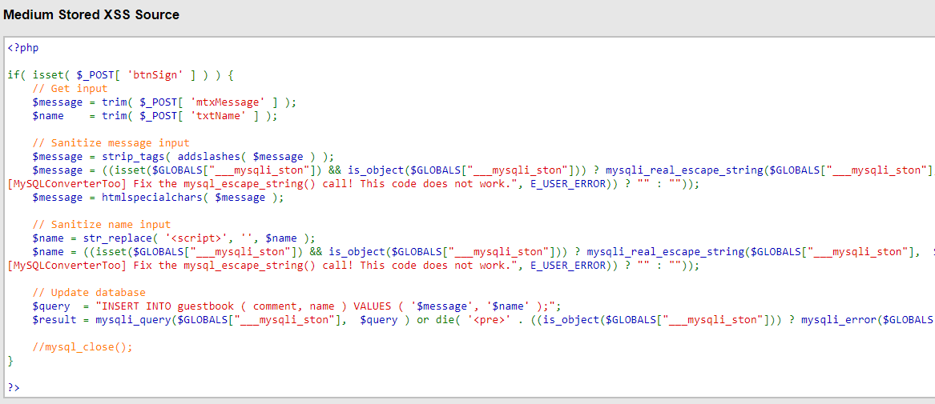
Stored XSS
Security Level : Medium

Slide 30
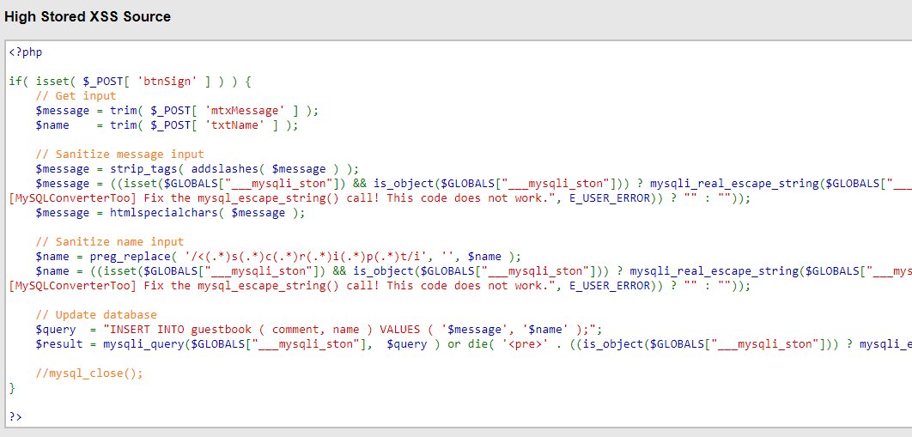
Stored XSS
Security Level : High

Slide 31
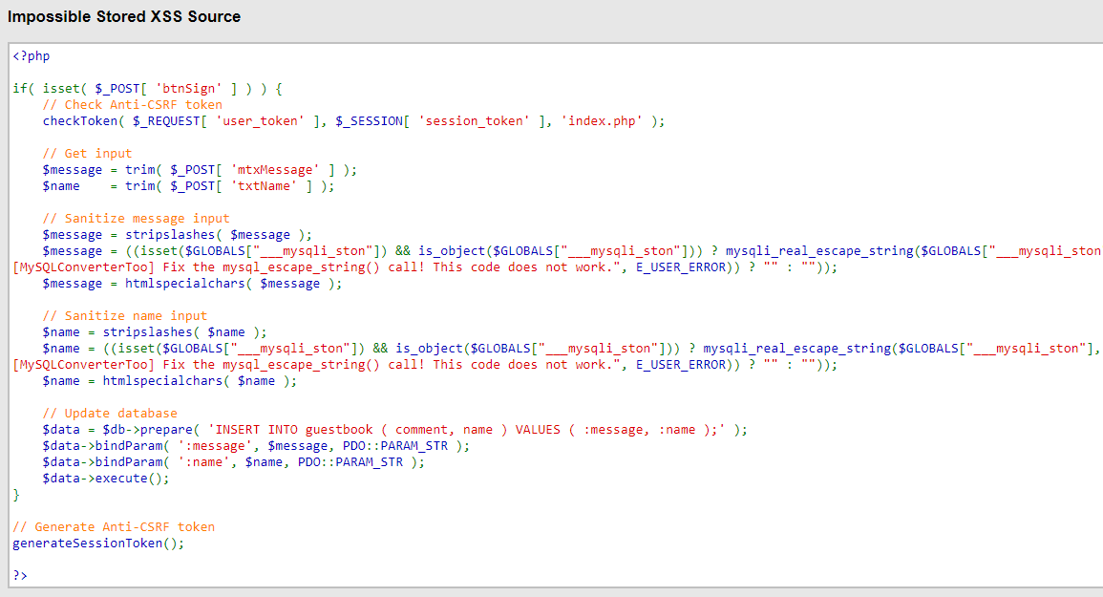
Stored XSS
Security Level : Impossible

Slide 32
How to prevent XSS vulnerability

Slide 33
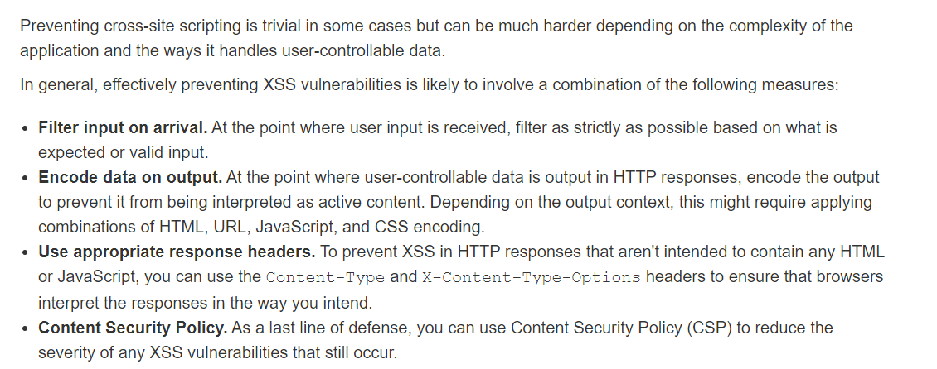
How to prevent XSS attacks

Slide 34
XSS attack automation

